Slide 1

Game Design
Mr Butler’s

Slide 2
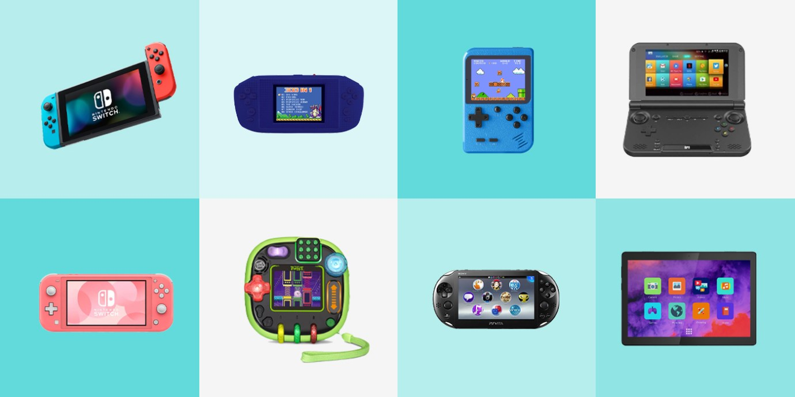
Game Consoles and Devices
Electronic games can be played on devices including:
  Game Consoles
  Mobile Phones
  Computers
These are also known as Game platforms.
These platforms have been developed for many generations, and we have moved from the installation of discs on game consoles and single player to now using cloud technology and playing online multiplayer games.

Slide 3

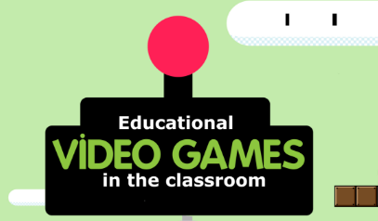
Educational Gaming
Educational gaming applications allow users to apply their knowledge and support their learning within a virtual world.
Features such as leader boards help motivate individuals to improve their scores
Can take on different roles within the game and reflect on what happened in certain situations, enhancing learning
Games are designed with rules and increasing levels of difficulty – the user must comply with the rules and cannot move to the next level before completing the previous.

Slide 4

Discussion: What makes a good game?

Slide 5
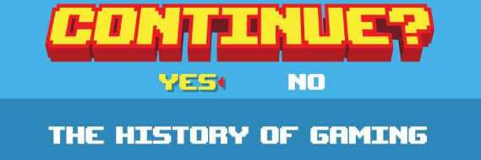
The history of video games goes as far back as the early 1950s, when academic computer scientists began designing simple games and simulations as part of their research or just for fun.
At M.I.T. in the 1960s, professors and students played games such as 3D tic-tac-toe and Moon Landing.
These games were played on computer such as the IBM 1560, and moves were made by means of punch cards.
Video gaming did not reach mainstream popularity until the 1970s and 1980s, when video arcade games and gaming consoles using joysticks, buttons, and other controllers, along with graphics on computer screens and home computer games were introduced to the general public.

Slide 6
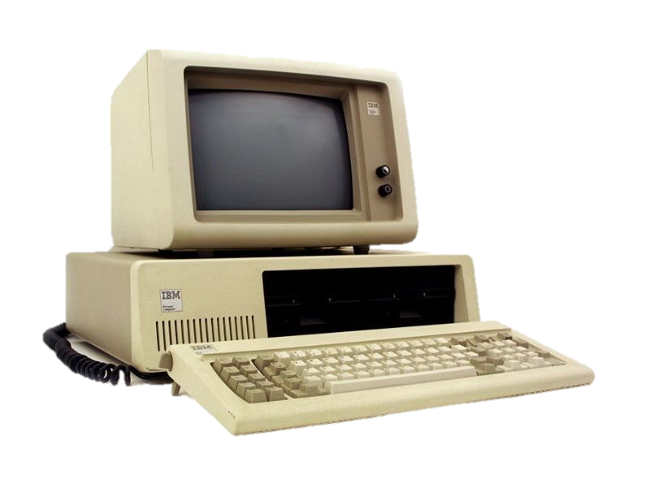
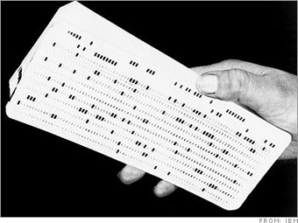
The IBM 1560
Name: IBM 1560
Year of Manufacture: August 12, 1981
Type: Personal Computer
Memory: 16kb-640kb
Sound: 1-channel PC speaker
OS: IBM BASIC / PC DOS
Punch cards held the game

Slide 7
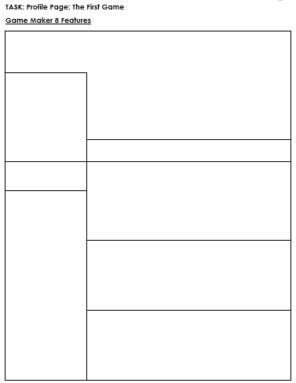
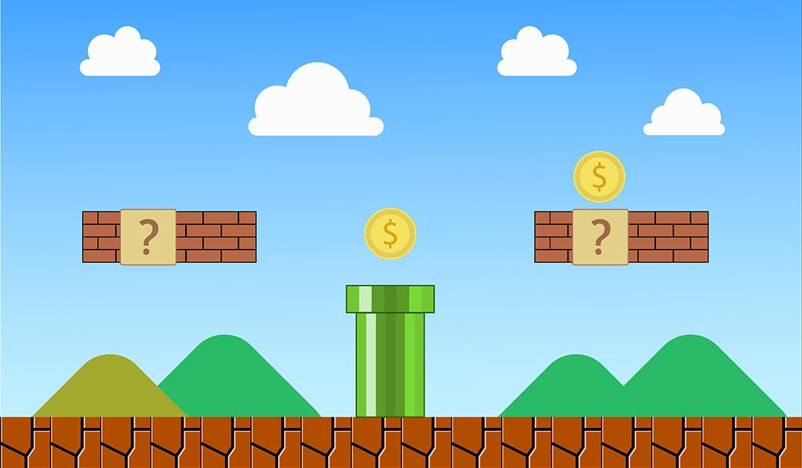
So what was the first game?
COVER PHOTO
PICTURE
NAME OF GAME
Using the internet, research the first video game created.
Complete the profile page for this game. You can stick images into this profile page also.
DOB
WHY WAS IT CREATED?
KEY TERMS / KEY NAMES / WHO CREATED IT?
HOW DID PLAYERS INTERACT WITH IT?
HOW DID YOU WIN THE GAME?

Slide 8

2D game engine which allows us to design, build (and play!) a 2D game.
The engine allows us to use drag and drop options, meaning that a game will not need to be programmed in the way that we can still develop a game without needing to develop the code behind these drag and drop features.
The Game Maker software splits its game creation into several areas/categories

Slide 9


Theory: Sprites
A sprite is an image, or a number of images, that represents something in the game.
  If the sprite is not animated, will be one picture
  If it is animated, the sprite has a number of sub-images.
Many games use multiple sprites with different animations each to represent one character performing different actions such as walking, jumping and falling.

Slide 10
Let’s Create a Sprite
Tutorial Part 1

Slide 11
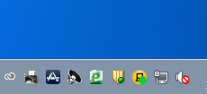

Open My Apps.

Slide 12
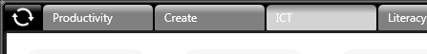
Select the ICT Tab

Slide 13
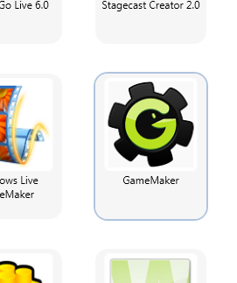
Double click on GameMaker

Slide 14
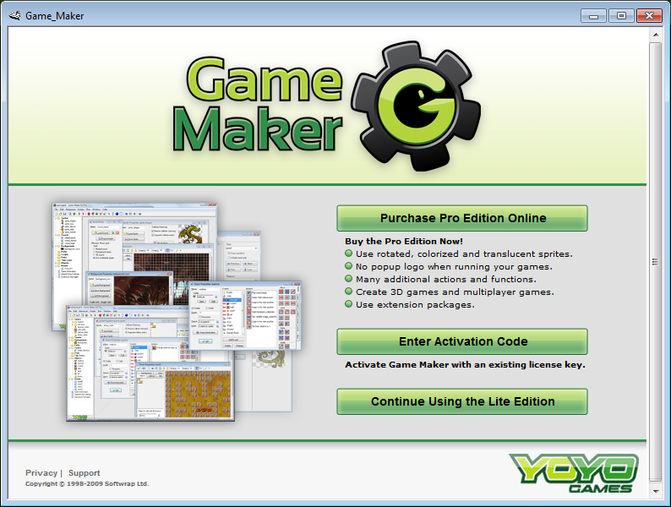
Click on
Continue Using the Lite Edition

Slide 15
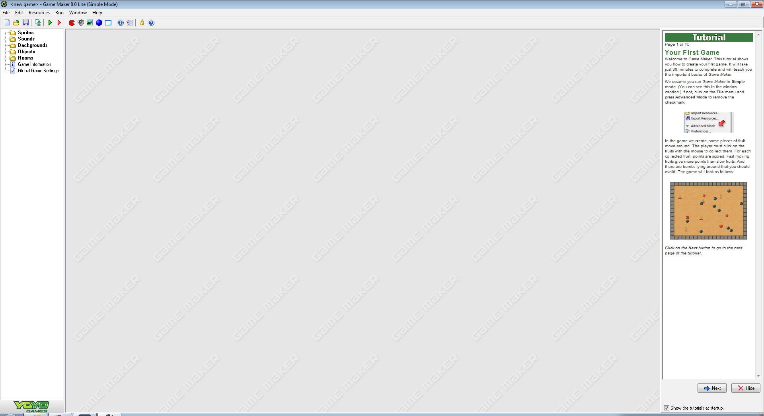

Slide 16
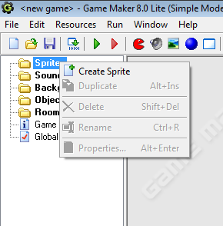
Right Click on Sprite.
Click Create Sprite

Slide 17
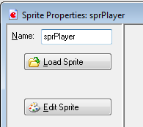
We need to name this Sprite.
Name this one sprPlayer.
Then Click Edit Sprite.

Slide 18
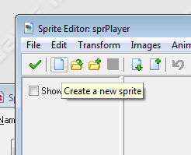
Click The Sheet of Paper.
This will create a ‘New’ sprite / image

Slide 19
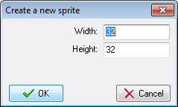
Leave the Width and Height as 32.
Click OK to start editing!

Slide 20
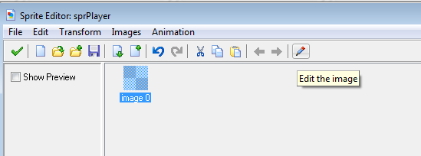
Click on the Pen to start editing this sprite.

Slide 21
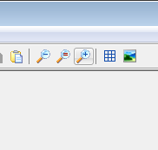
The image will be very small. Click the magnifying glass with the + sign to make the image bigger.

Slide 22
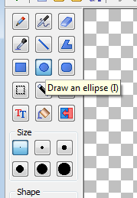
Use the toolbox to create an image for your player.
Make Sure you fill the area. Remember this will be very small on screen!

Slide 23
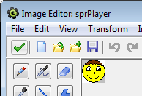
Once we have made the player, we can click the Green Tick to confirm

Slide 24
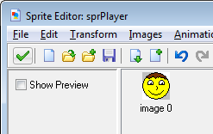
We can now see a preview of our sprite/character.
Click the Green Tick Again to save.

Slide 25
We now need to create:
- A Square Wall (labelled as sprWall)
- A Bad Guy (labelled as sprEnemy)
- A Collectible (a key of some description, labelled as sprKey)
Remember! You only have this lesson to create all of these! So don’t spend too much time perfecting them – we can do this at the end!

Slide 26
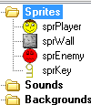
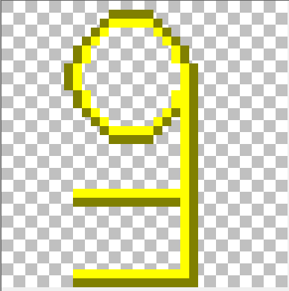
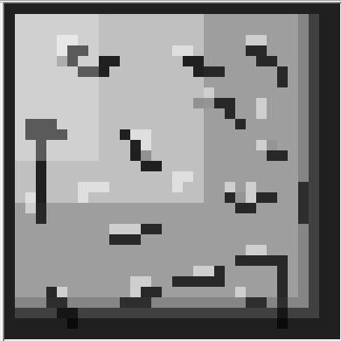
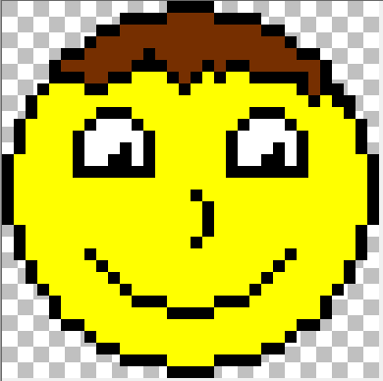
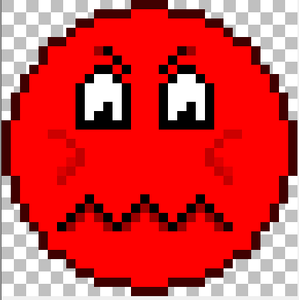

Slide 27
Theory: Objects
In order to interact or see a sprite in the game, you need to make it an object – however not all objects need sprites and there are cases we will create an object without an image!
This means you can perform actions on the object, move an object or simply be able to see it on the screen.
However, this object is not placed into the game, but rather acts as a template for instances which are placed into rooms.
An instance is basically a copy of the object that is placed in the room (level) of your game.
So, you could make one tree object and then place one hundred instances of this tree in the room.

Slide 28
Let’s Create an Object
Tutorial Part 2

Slide 29
Let’s Make The Player Move

Slide 30
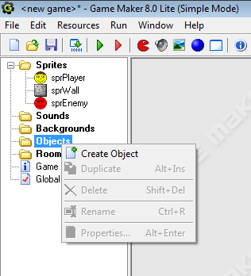
Firstly, we need to make a New Object.
An Object is something we can put into the game itself.

Slide 31
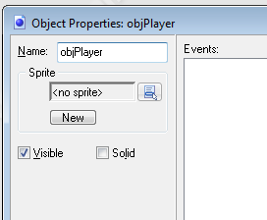
Now Click on this Icon next to the <no sprite> text.
Select your sprPlayer

Slide 32

We also want to ensure Solid is checked.

Slide 33
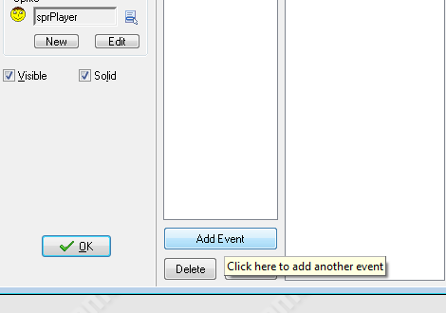
Click on the Add Event.

Slide 34
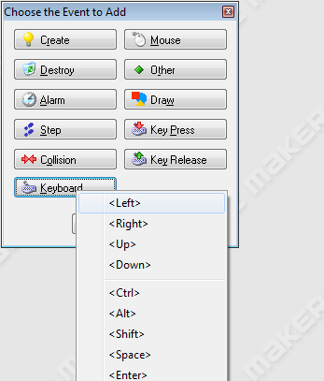
In the Popup, select Keyboard > Left

Slide 35
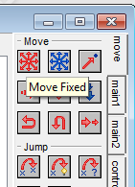
In the Move tab, we want to use the red arrows icon. The tooltip reads ‘Move Fixed’

Slide 36
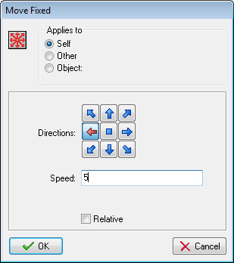
Once you have dragged the Move Fixed Icon over, you need to click the Left Arrow. Set it with a Speed of 5.
Then Click OK.

Slide 37
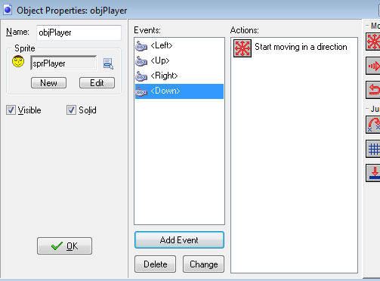
Repeat this for Up, Down and Right.
Q. Can you think of what will happen if no Key is pressed?

Slide 38

Click OK to save.

Slide 39
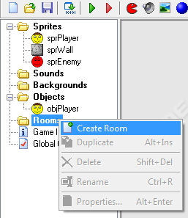
We now need to create a Room for our Character.

Slide 40
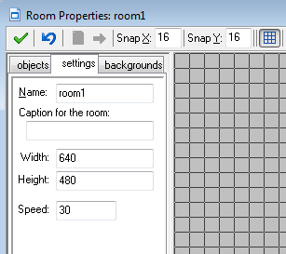
Once you have clicked on this, Go to the settings tab. Give the room a meaningful name. We will call this rmPractise.
Further Task: Add a caption for the room.

Slide 41
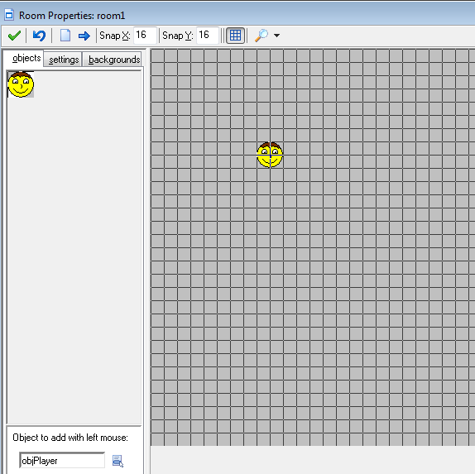
Go to the objects tab.
At the bottom, make sure objPlayer is selected.
Then click anywhere in the tiled area.

Slide 42
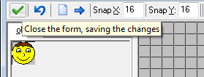
Click on the Green Tick to Save your Room

Slide 43
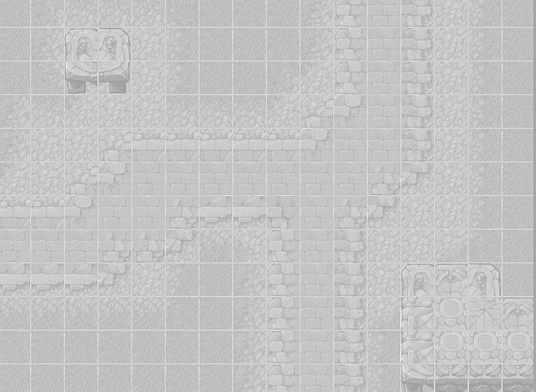
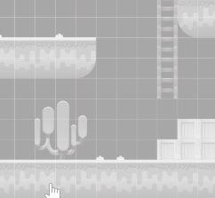
Theory: Rooms
A room in Game Maker is important to include in every game. This is the area we use to add in objects.
Not only should you have a room for each level, but you should also have a room for the opening screen, help pages and any credits/end screens you will have.
You must have at least one room in any game for it to run, but in general you will need many more.
The room will be a design of what the player will see when they play a game. It is important that we create these to be very atheistically pleasing to ensure players are interesting in playing your game.

Slide 44

Theory: Sound
Sound, or commonly known as audio, is an important part of creating an engaging game that keeps players interested in the gameplay and mechanics of a game.
Two main aspects of audio in games:
  Background music
  SFX (aka. Special effects)

Slide 45
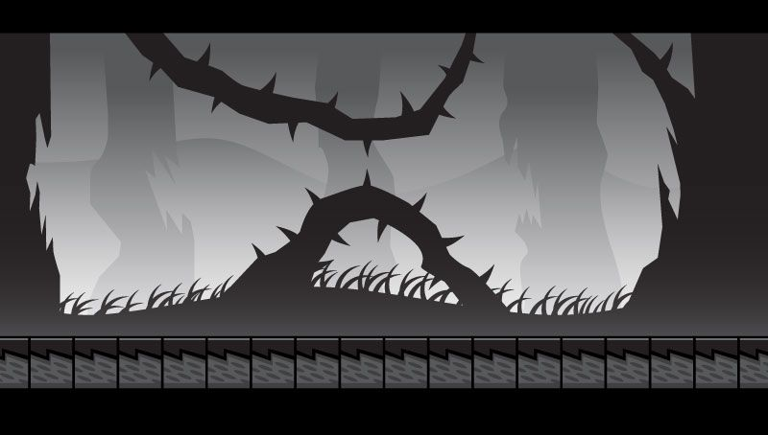
Theory: Backgrounds
Much like sound, the background can drastically change the mood or feeling of a game.
Using dark backgrounds can make a game seem scary or using a light background could make the game a lot more child-friendly in its approach to gaming.
It is important that the background reflects the genre of the game, as mis-matching elements can mean that the game becomes clunky and unsuitable for its target audience.

Slide 46
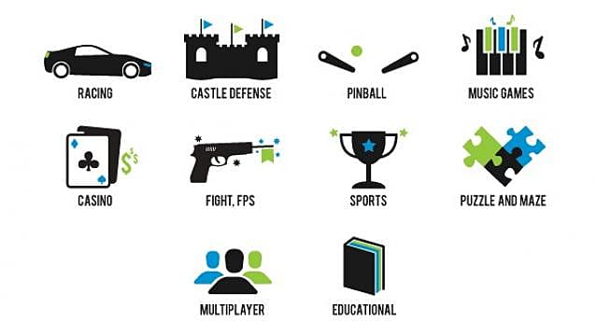
Theory: Genres
A genre identifies the style or category of a piece of work, like a book, poem or film. Games also fall into different genres.
Games are not usually defined by the actual content of the games, but rather by the challenges, story and gameplay that are contained within the game.

Slide 47

Genre: ACTION!!!!!!!!
Action games emphasize physical challenges that require Hand-eye coordination and motor skill to overcome.
  They center around the player, who is in control of most of the action.
  Most of the earliest video games were considered action games; today, it is still a vast genre covering all games that involve physical challenges.
Action games are classified by many subgenres.
  Platform games and fighting games are among the best-known subgenres.

Slide 48

Genre: Adventure
Unlike adventure films, adventure games are not defined by story or content.
  Rather, adventure describes a manner of gameplay without reflex challenges or action.
They normally require the player to solve various puzzles by interacting with people or the environment, most often in a non-confrontational way.
It is considered a "purist" genre and tends to exclude anything which includes action elements beyond a mini game.

Slide 49
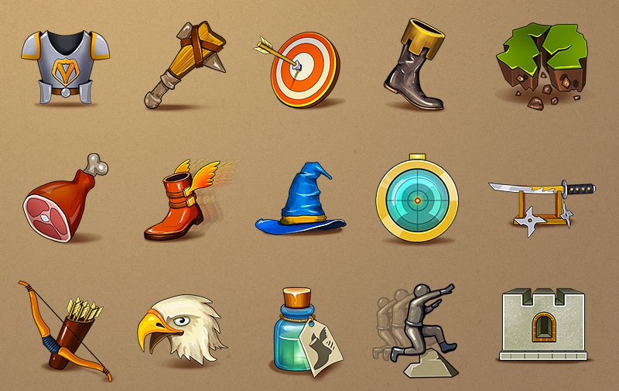
Genre: Role Playing (RPG)
Most of these games cast the player in the role of one or more "adventurers" who specialize in specific skill sets (such as melee combat or casting magic spells) while progressing through a predetermined storyline.
Many involve manoeuvring these character(s) through an overworld, usually populated with monsters, that allows access to more important game locations, such as towns, dungeons, and castles.

Slide 50


Genre: Are we in a Simulation?
Simulation video games is a diverse super-category of games, generally designed to closely simulate aspects of a real or fictional reality.

Slide 51
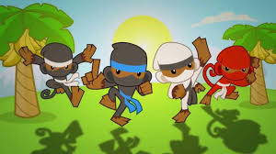
Genre: Have you got a good strategy?
Strategy video games focus on gameplay requiring careful and skilful thinking and planning in order to achieve victory and the action scales from world domination to squad-based tactics.

Slide 52

Genre:
Are you good at sports?
Sports are video games that simulate sports.
This opposing team(s) can be controlled by other real-life people or artificial intelligence.

Slide 53

Task: Genres
Pick two different genres from the previous slides and research them.
Produce an A4 poster describing both, with examples of real games or popular games as examples. Describe how the games fall into the genre(s).
Record the Game Information into your booklet.

Slide 54
Let’s Create more of our Game
Tutorial Part 3

Slide 55

To test run your game, you can click on the green arrow / triangle at the top of GameMaker.
Click Escape to Exit the Game

Slide 56
What do you notice about the character. Does he stop when you press nothing?

Slide 57
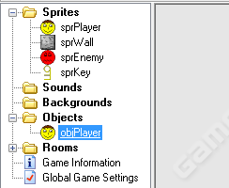
We will fix this now. Double click on your objPlayer.

Slide 58

Much like the other events, we are going to add another keyboard event.
Click Add Event again and select Keyboard.

Slide 59
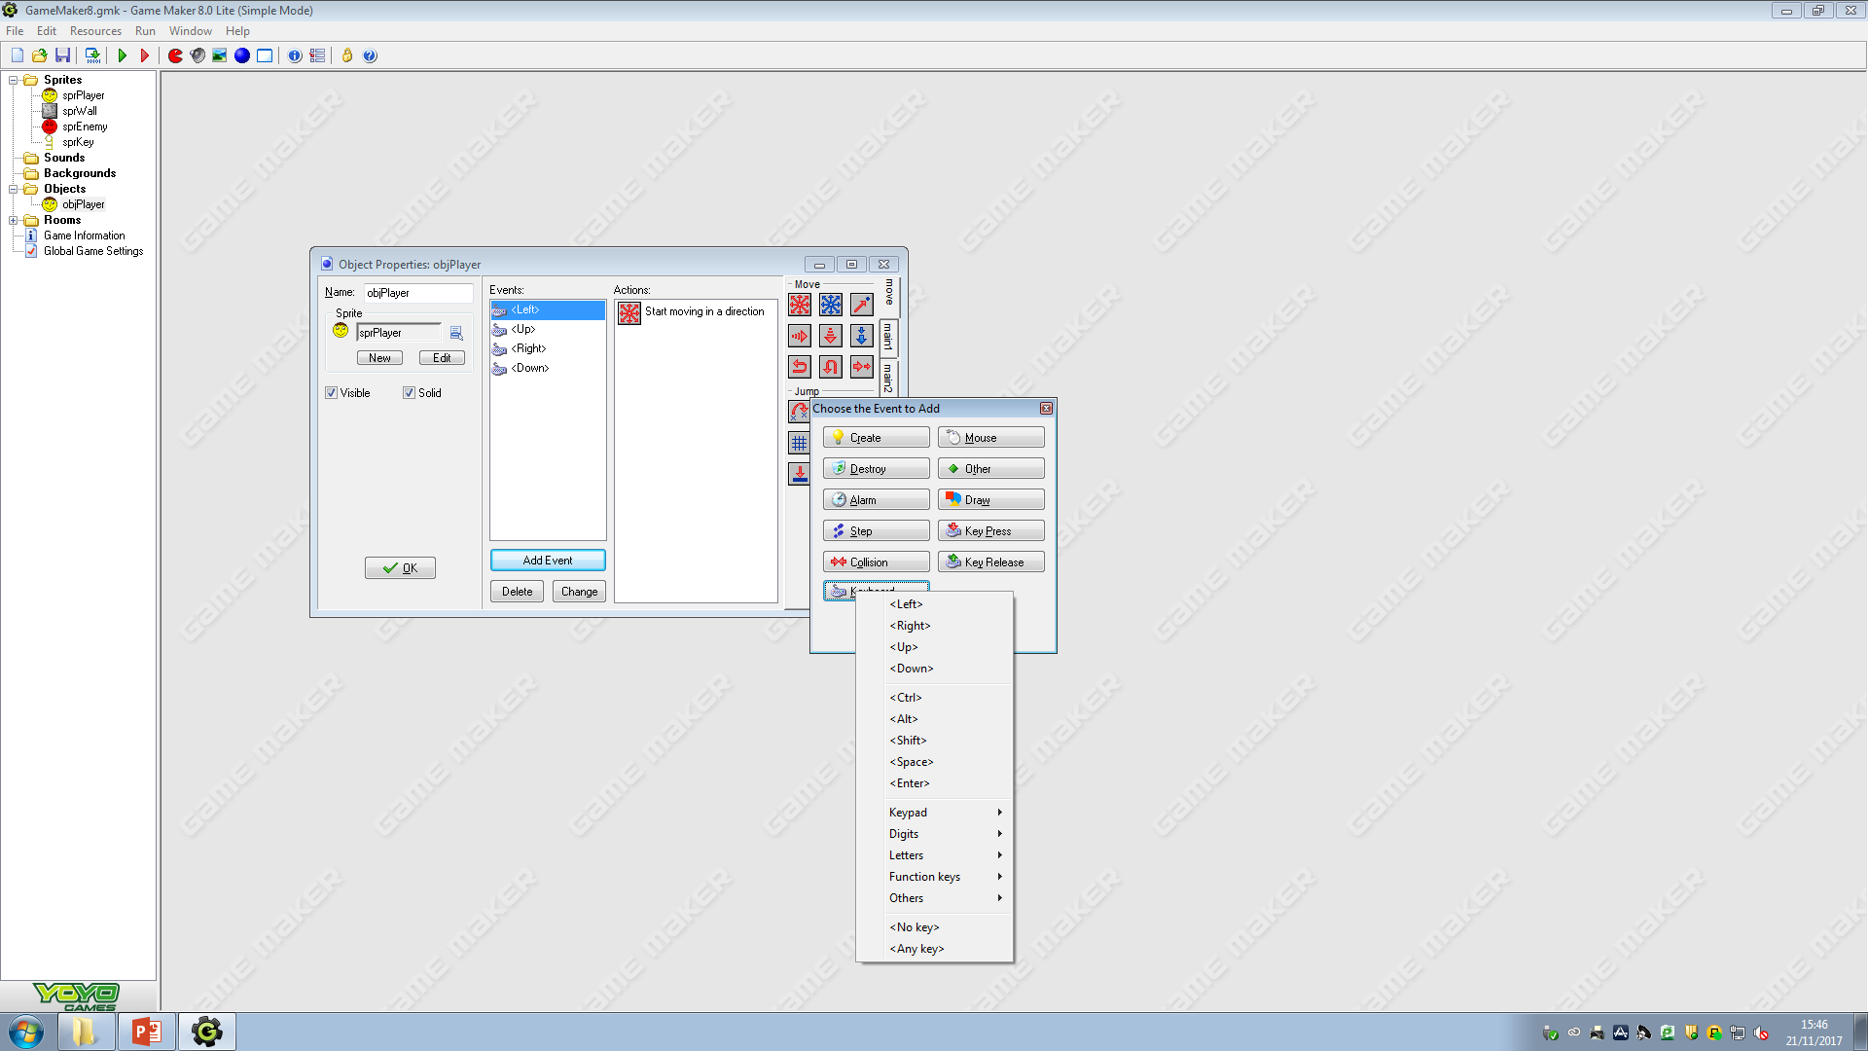
Which of these keyboard events do you think will allow us to check if we’re not pressing a directional key?

Slide 60
So, select <No key>. That way we can tell no key is being pressed.

Slide 61
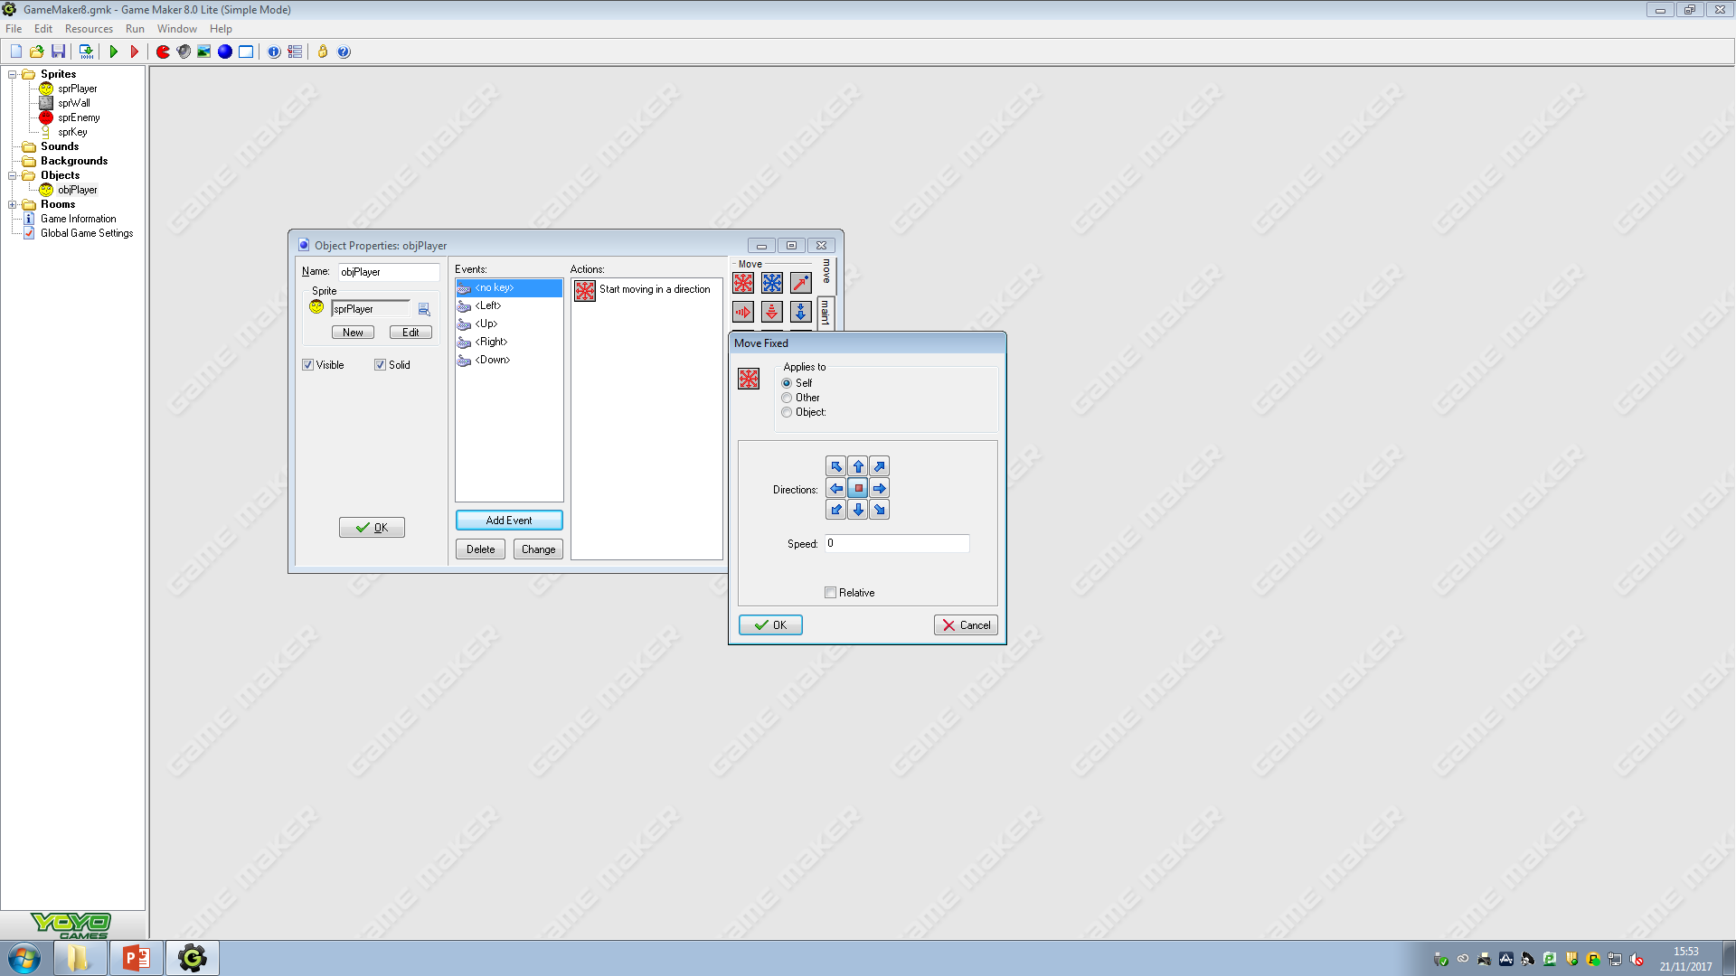
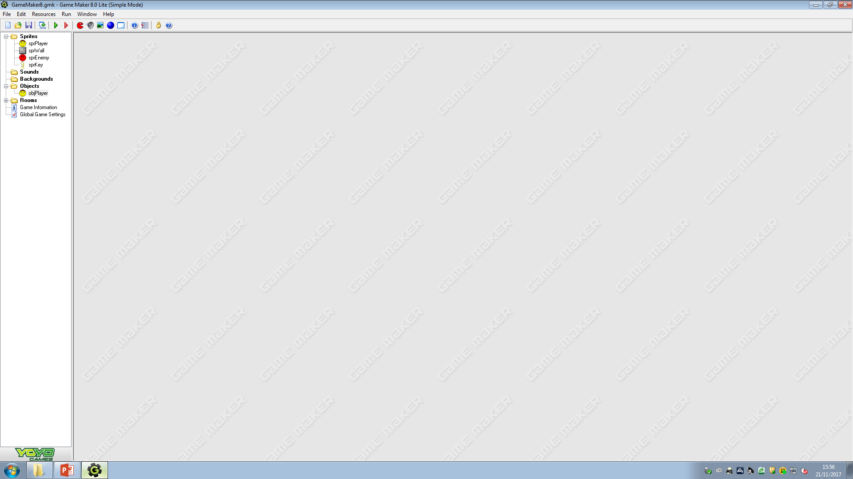
We want the player to stop when no key is pressed, so we need to click on the square in the centre. Set a speed of 0
Run your game to test if your player will stop when no key is pressed

Slide 62
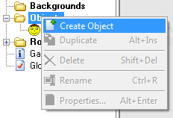
Let’s now stop the player from being able to leave the room.
Right click on Objects and select Create Object again.

Slide 63
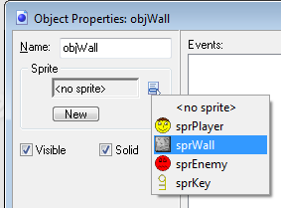
Name this object objWall, the sprite should be set as sprWall and we need this to be solid

Slide 64
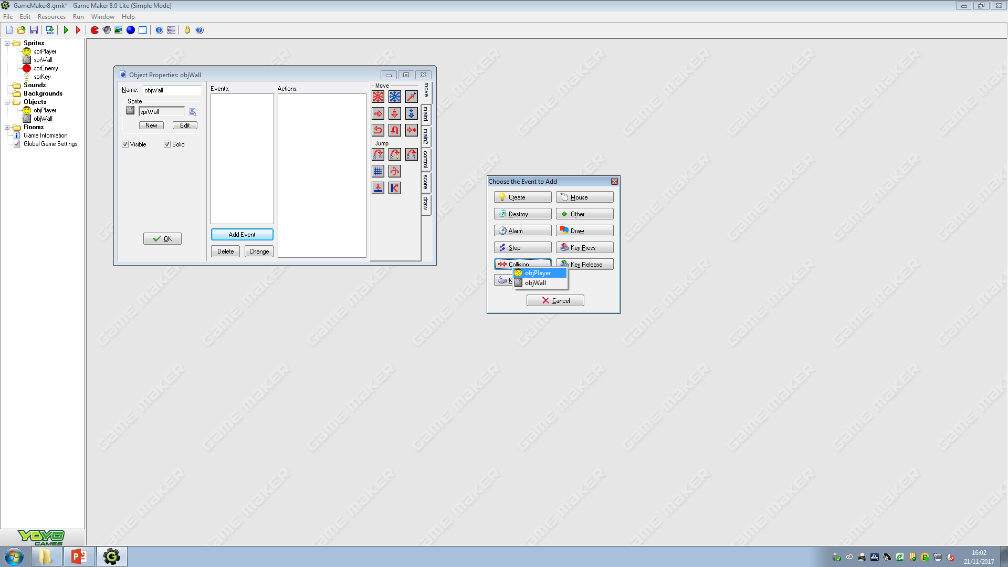
Whilst still on the objWall object, we need to check if the player crashes into the wall. So we need to Add Event.

Slide 65
Whilst still on the objWall object, we need to check if the player crashes into the wall.
So we need to Add Event.
Select Collision.

Slide 66
We are going to run when the objPlayer and objWall are colliding together.
To do this, we need to select objPlayer.

Slide 67
Much like we did for the ‘no key’ being pressed, we can use the ‘move fixed’ option.
Except this time, we need to stop the Other object (the player).

Slide 68

Go into your PractiseRoom and add walls around the entire room. Add some in the middle too.
Run your game to see if the player can move through the wall.

Slide 69

Oh no!
The Character can’t fit through the gap!
We need to make our character slightly smaller.

Slide 70

Exit the game by pressing Esc.
Double click on our sprPlayer.
Now click Edit Sprite

Slide 71

On the menu bar there is a dropdown for Transform. Select Scale…

Slide 72

In the Scale popup, set the Percentage to 80
Make sure both Horizontal and Vertical is checked, otherwise you’ll stretch your sprite.

Slide 73

Run your game now. You character should be able to fit through the gaps!
Repeat this for your sprEnemy

Slide 74
In our game, if the key is collected, we’re going to progress to the next level.

Slide 75
Exit the game’s preview. We’re now going to make the key object.

Slide 76

Right Click on Objects and click Create Object.

Slide 77

Keep the naming convention the same.
Set the Sprite.
Set this to be solid.

Slide 78

Add the objKey into your room.
Run your game.
What happens when you hit the key?

Slide 79

We can run over the key. Why is this?

Slide 80


Double click on the objKey.
We’re going to Add Event > Collision > objPlayer

Slide 81

Click on the main1 tab.
Under rooms, there is an option for Next Room.
Drag this into the Actions Section.
Drag

Slide 82

We can add a transition effect to add between levels.

Slide 83

Hit Ok and test your level.
What happens now when you hit your key?

Slide 84

FATAL ERROR
Why? It was going so well?

Slide 85

This was caused by not having another room to go to.
We’ll add another room now.
We’ll call it rmlevelOne

Slide 86

Make sure you add an objKey as well as a player to your new level!
Then hit the green tick to save

Slide 87
Run your game. When you hit the first key, you should progress to ‘level One’.

Slide 88


Gaming Platforms
How do we play games?
What do we use?
Where are we?
Hardware/Software?

Slide 89

Game Platforms
Typically, we use gaming consoles, such as Play Stations and Xboxes as the platform to play many games.
  The games that we play may be purchases and played online, for a monthly subscription or purchased in store and inserted into the game console.
Mobile gaming is becoming more and more popular, with games available for purchase and download through the app stores for mobile phones or tablets.
  Many of these games are played in the same kind of way, navigating through levels to collect credit and ultimately win at the end.
  However, a newer and less common technology is immerging, and their popularity is increasing rapidly.
These technologies are called VR and AR.

Slide 90

VR
stands for Virtual Reality
It’s a world that doesn’t exist.
  This virtual reality has been created by a computer, which allows users to experience and interact with a 3D world
  uses a VR headset
  Additional technologies can be incorporated to add sound and movement.
The most well-known example of VR is Minecraft. Minecraft allows users to build a variety of different blocks in a 3D procedurally generated world, using the players creativity.

Slide 91

AR
stands for Augmented Reality
  This means adding computer generated images into real life
  For example, some furniture shops have an app or additional functionality on their websites, which allow users to view pieces of furniture in their own rooms.
  This incorporated the use of device cameras and their internet connection.
Biggest example is Pokemon Go

Slide 92
Let’s Create more of our Game
Tutorial Part 4

Slide 93
We’re now going to add another object to our game.
We’ll name this one objEnemy.

Slide 94

Right Click on Objects > Create Object

Slide 95

objEnemy
Set The Sprite
Visible AND Solid

Slide 96


Go To Add Event > Create

Slide 97
In the Move tab, we want to use the red arrows icon. The tooltip reads ‘Move Fixed’

Slide 98

Set The Direction to Up down left and right at a speed of 5.
Then Hit OK

Slide 99

Add another Event
This time we are going to Collision > objWall

Slide 100


Add a Move Fixed block
Again, add the up down left and right with a speed of 5

Slide 101
Get adding!
Add some enemies into your game (not too many!!!)
Then test your game to see if there’s anything wrong

Slide 102
Q) What happens if the enemy hits you?
We need to add another collision event!

Slide 103


Go to objEnemy.
Add Event > Collision > objPlayer

Slide 104

Drag the Destroy the Instance into your Actions section

Slide 105

Now under main2 add a Display a Message Option

Slide 106


Slide 107

Under Score
Drag the Set Lives into your actions.

Slide 108

Set the new lives to -1
Check it is relative.
Now hit OK.

Slide 109

Now we need to use the Test Lives option

Slide 110

Set the Value to 0. Set the operation to equal to.
Then press OK

Slide 111

Under the Control tab, use the Start Block.

Slide 112

Now go to the score tab and drag the Show Highscore option

Slide 113

Go to the main2 tab.
Under the Game section, use the restart game option.

Slide 114

Go to the control tab. Drag a closing block underneath your actions.

Slide 115

Now add an Else block.

Slide 116

See if you can find these blocks now to finish our code.

Slide 117

This should be the completed code.
Check yours is correct otherwise it won’t work!

Slide 118
Click OK and run your game. What happens if we collide with our enemy now?

Slide 119

Let’s set up how many lives we should have

Slide 120

Right Click Objects > Create Object

Slide 121

Give this object a Name: SetScore

Slide 122

Click on Add Event > Create

Slide 123

Under the Score tab, select SLH
Drag this onto your actions section.

Slide 124

We need to Show Score and also show Lives.
Set these to Show.
Then press OK

Slide 125

Still under the score tab, you need to drag the set lives option into your actions list.

Slide 126

Set your lives to 3.
Then press OK

Slide 127

This is what your SetScore object should look like.

Slide 128

Double Click on the practiseRoom or rmPractise (the first room) to open its editor

Slide 129

Go back to your objects tab. Select SetScore and click once anywhere in your room.
It should appear as a ? As it does not have a sprite to display.

Slide 130

Press the green tick to save and then run your game. Your game should display the score and lives.

Slide 131
Let’s now add a ‘end game’ or ‘game finished’ screen.

Slide 132

Right Click Objects > Create Object

Slide 133

Name this object finishGame. It does not require a sprite.

Slide 134

Add Event > Create

Slide 135

Under main2 tab, there is an option to display a message.
Drag this onto your actions area.

Slide 136

Set up the message as
You Win!
Then press OK

Slide 137

Under the score tab, drag the ‘show highscore’ option into your actions.

Slide 138

This will allow you to customise what the highscore table will look like.
We can come back to this but let’s skip it for now.
Hit OK.

Slide 139

Click on the main2 tab.
Then use the ‘Restart Game’ action.

Slide 140

Is this what your code now looks like?
Perfect!
Click the Green Tick to save

Slide 141

Right Click on Rooms > Create Room

Slide 142

Under the Settings tab, set the name as YouWin

Slide 143

Go now to the objects tab. Select the object finishGame we have just created.

Slide 144

Click anywhere in the room.
Q. Why do we get the ? Again?

Slide 145
Save your work by clicking on the green tick.
Now run your game. Does everything work?

Slide 146

You can add new rooms/levels.
Make sure they appear between the PractiseRoom and YouWin!

Slide 147
Extensions
Can you add a front page to your game (Press space to start?)
Add in some collectibles (coins) into your game.
On collision, you need to:
    Destroy Instance
    Increase Score By 10 (relative)

Slide 148

Scoring and its Importance in Gaming
Scoring refers to an abstract quantity associated with a player or team
Most games with score use it as a quantitative indicator of success in the game, and in competitive games, a goal is often made of attaining a better score than one's opponents in order to win.
Scoring is very different from game to game
  Seen as a ‘way to win’ a game
  Fortnite for example uses a ‘last man standing’ approach instead of a high score table.
  Some games include no score at all, yet you can still ‘win’

Slide 149
Target Audience
The ‘target audience’ can be defined as a particular group at which a product such as a film or advertisement is aimed.
When developing a game, it is very important to keep the target audience in mind as it will ultimately be those players who will be playing your game.
A game such as Fortnite will be aimed a majority young teens, yet a game like Chess will be aimed at logical thinkers and a more mature generation of gamer.

Slide 150


TASK:
Target Audience
In your booklets there are two photos of games. Decide what would the target audience.
Explain why you think this is the case.
  Hint: Think about the colour schemes, icons, gameplay you think there is.

Slide 151

Practical Assessment
Magic Amusements

Slide 152


Magic Amusements
Magic Amusements are an up and coming Game Development company, situated in Belfast. They specialise in 3D games, however are wishing to expand their company by developing a 2D game aimed at teenagers aged 10-14.
The Game should be developed using the Game Maker software, and should have a continuous theme throughout. The title of the Game has been left to you to decide, but should be suitable to the target audience.

Slide 153
Magic Amusements
The aim is to create an engaging first product which will allow the user to:
View an introductory Title Screen, which includes a company logo and information of how to access the main menu
A Main menu, which allows the user to:
  Start the Game
  Access A help feature
  View Highscore
  Load the previously saved game
  View Credits of the Game
At least three levels, each of which get slightly harder. All levels should be possible to complete
A Scoring system
Collectables

Slide 154

Magic Amusements: Planning

Slide 155
Magic Amusements: Creation
Let’s Get Creating!
I will of course help you as you go along.
Just remember to use your storyboarding sheet to help!

